Slide 1
Understanding Unity's Component System

Slide 2
Learning Objectives
Understand the concept of Unity's component system.
Explore common components and their roles.
Grasp the significance of component-based design in Unity.

Slide 3
What is Unity's Component System
The Entity Component System (ECS) is the core of the Unity Data-Oriented Tech Stack (DOTS). As the name indicates, ECS has three principal parts:
Entities — the entities, or things, that populate your game or program.
Components — the data associated with your entities, but organized by the data itself rather than by entity. (This difference in organization is one of the key differences between an object-oriented and a data-oriented design.)
Systems — the logic that transforms the component data from its current state to its next state— for example, a system might update the positions of all moving entities by their velocity times the time interval since the previous frame.
8: Unity Technologies, Unity Manual, 2023
Notes:
ECS is a framework / software architectural
https://docs.unity3d.com/Packages/com.unity.entities@0.17/manual/index.html

Slide 4
What is Unity's Component System
In a component system, components are mix-and-match packets of functionality, and objects are built up as a collection of components, rather than as a strict hierarchy of classes. A component system is a different (and usually more flexible) approach to object-oriented programming (OOP) that constructs game objects through composition rather than inheritance. ^{[1]}
In a component system, objects exist on a flat hierarchy, and different objects have different collections of components. An inheritance structure, in contrast, has different objects on completely different branches of the tree. The component arrangement facilitates rapid prototyping, because you can quickly mix and match components rather than having to refactor the inheritance chain when objects change.
1: Hocking, Joseph; Schell, Jesse, Unity in action: multiplatform game development in C#, 2022

Slide 5
What is Unity's Component System
Unity
Game Objects
Unity Components: Transform, MeshFilter, Renderer, Colider, Rigidbody, Script component
RenderSystem: SpriteRenderer, MeshRenderer, ParticleSystemRenderer MovingSystem: PhysicSystem: behaviour of RigidbodyComponent, ColliderComponent ...
ESC
Entity
Component
System
Notes:
GameObject là một container để “chứa” các components
Component trong Unity đều kế thừa từ class Component. Và các script mà các bạn viết kế thừa từ MonoBehaviour, cũng là class con của Component

Slide 6
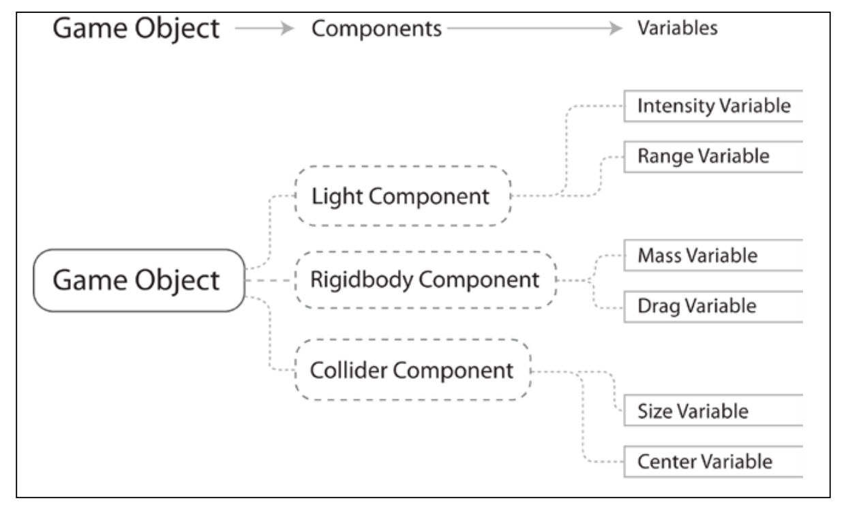
Components in Unity
In Unity, components come in various forms. They can be for creating behavior, defining appearance, and influencing other aspects of an object's function in the game.
By attaching components to an object, you can immediately apply new parts of the game engine to your object. ^{[10]}
Components are one of the three principle elements of an Entity Component System architecture. They represent the data of your game or program.^{[8]}
10: Goldstone Will, Unity 3.x game development essentials, 2011
8: Unity Technologies, Unity Manual, 2023
Notes:
https://docs.unity3d.com/Packages/com.unity.entities@0.1/manual/ecs_components.html
Components are the actual data containers. They are structs that hold values without any logic, and you’ll no doubt have a lot of them. ECS revolves around storing these small Components in a clever way.
https://www.kodeco.com/7630142-entity-component-system-for-unity-getting-started
https://docs.unity3d.com/ScriptReference/Component.html

Slide 7
Components in Unity
Common components of game production come built-in with Unity, such as the Rigidbody component mentioned earlier, down to simpler elements such as lights, cameras, particle emitters, and more ^{[10]}
To build further interactive elements of the game, you'll write scripts, which are also treated as components in Unity. Try to think of a script as something that extends or modifies the existing functionality available in Unity or creates behavior with the Unity
scripting classes provided. ^{[10]}

Slide 8
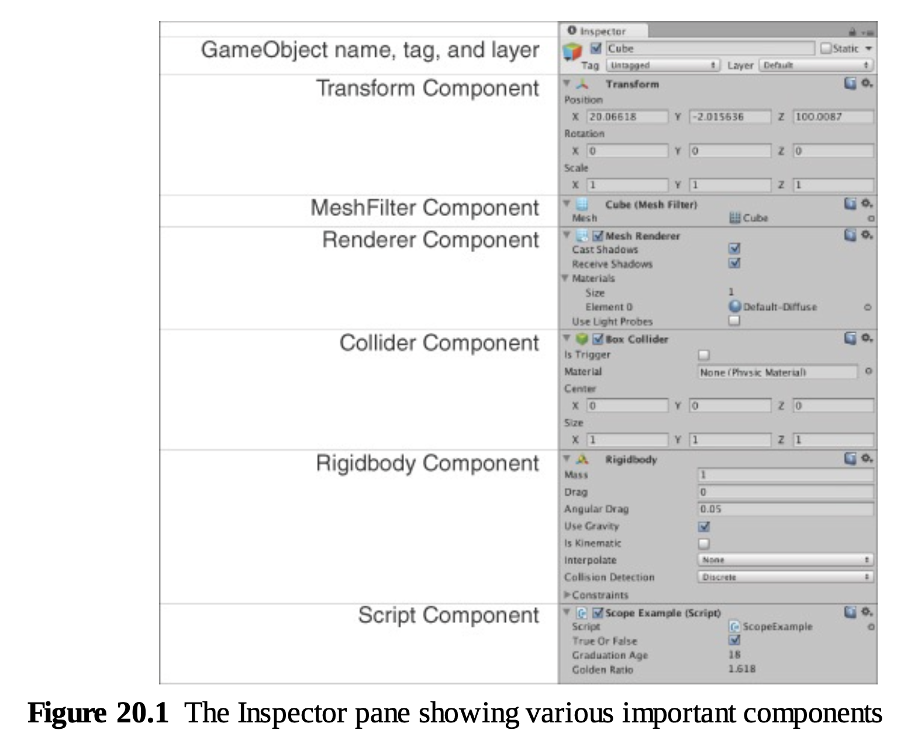
Common Components in Unity
Components | Using / Datastore
Transform | Position, Rotation, scale
Renderer | Object appear on the screen
Collider | Define the shape of an object for the purposes of physical collisions
Rigidbody | Add motion to GameObject under the control of Unity's physics engine.
Script | All code execution in Unity starts from code files linked to an object in the scene Scripts in Unity are more akin to individual OOP classes, and scripts attached to objects in the scene are object instances ^{[1]}
6: Gibson Bond, Jeremy, Introduction to Game Design, Prototyping, and Development: From Concept to Playable Game with Unity and C,
Notes:
https://docs.unity3d.com/ScriptReference/Renderer.html
https://docs.unity3d.com/560/Documentation/Manual/CollidersOverview.html
https://docs.unity3d.com/ScriptReference/Rigidbody.html

Slide 9
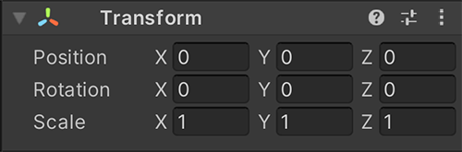
The Transform Component
Transform: Position, Rotation, and Scale
Transform is a mandatory component that is present on all GameObjects. Transform handles critical GameObject information like position (the location of the GameObject), rotation (the orientation of the GameObject), and scale (the size of the GameObject). Though the information is displayed in the Inspector pane, Transform is also responsible for the parent/child relationships in the Hierarchy pane. When one object is the child of another, it moves with that parent object as if attached to it.
6: Gibson Bond, Jeremy, Introduction to Game Design, Prototyping, and Development: From Concept to Playable Game with Unity and C,
Notes:
https://docs.unity3d.com/Manual/class-Transform.html

Slide 10
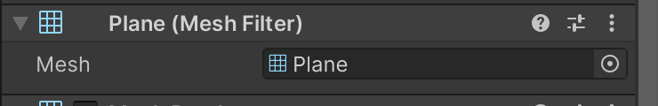
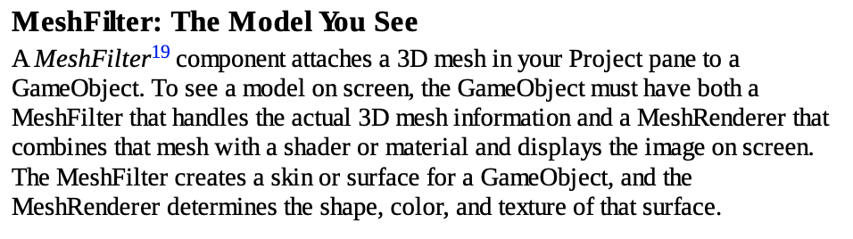
The MeshFilter Component
6: Gibson Bond, Jeremy, Introduction to Game Design, Prototyping, and Development: From Concept to Playable Game with Unity and C,
Notes:
https://docs.unity3d.com/Manual/class-MeshFilter.html

Slide 11
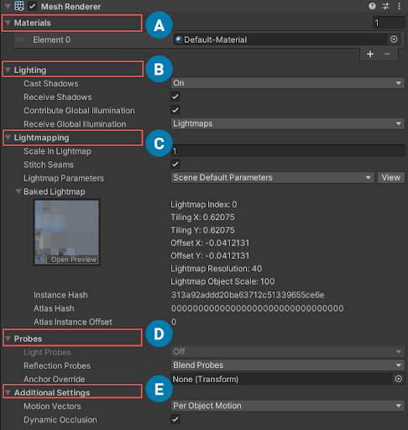
The Renderer Component
Renderer: Allows You to See the GameObject
A Renderer component—in most cases, a MeshRenderer—allows you to see the GameObject in the Scene and Game panes. The MeshRenderer requires a MeshFilter to provide 3D mesh data as well as at least one Material if you want it to look like anything other than an ugly magenta blob (Materials apply textures to objects, and when no Material is present, Unity defaults to solid magenta to alert you to the problem). Renderers bring the MeshFilter, the Material(s), and lighting together to show the GameObject on screen.
6: Gibson Bond, Jeremy, Introduction to Game Design, Prototyping, and Development: From Concept to Playable Game with Unity and C,
Notes:
https://docs.unity3d.com/Manual/class-MeshRenderer.html

Slide 12
The Rigdbody Component
Rigidbody: The Physics Simulation
The Rigidbody component controls the physics simulation of your GameObject. The Rigidbody component simulates acceleration and velocity every FixedUpdate (generally every 50th of a second) to update the position and rotation of the Transform component over time. It also uses the Collider component to handle collisions with other GameObjects. The Rigidbody component can also model things like gravity, drag, and various forces like wind and explosions. Set isKinematic to true if you want to directly set the position of your GameObject without using the physics provided by Rigidbody.
6: Gibson Bond, Jeremy, Introduction to Game Design, Prototyping, and Development: From Concept to Playable Game with Unity and C,
Notes:
https://docs.unity3d.com/Manual/class-Rigidbody.html

Slide 13
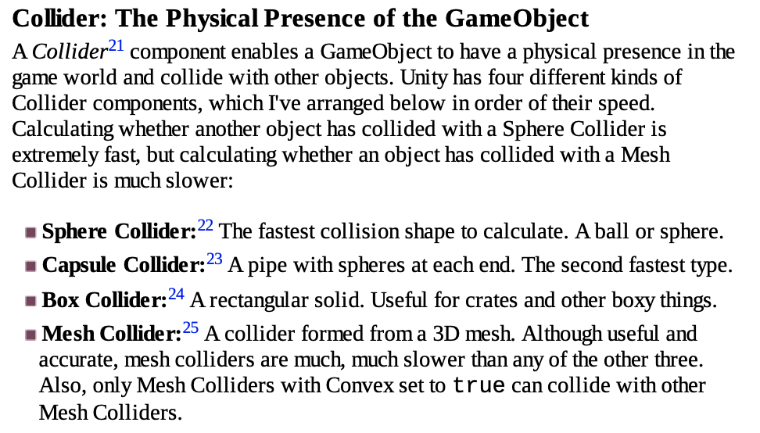
The Collider Component
6: Gibson Bond, Jeremy, Introduction to Game Design, Prototyping, and Development: From Concept to Playable Game with Unity and C,
Notes:
https://docs.unity3d.com/Manual/collision-section.html

Slide 14
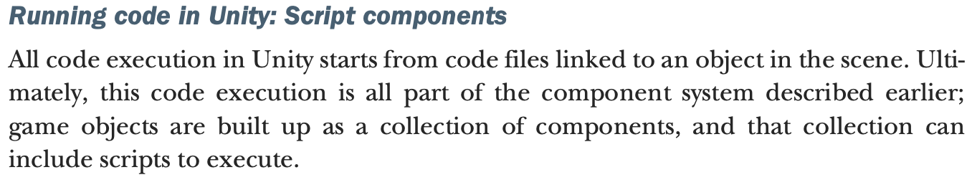
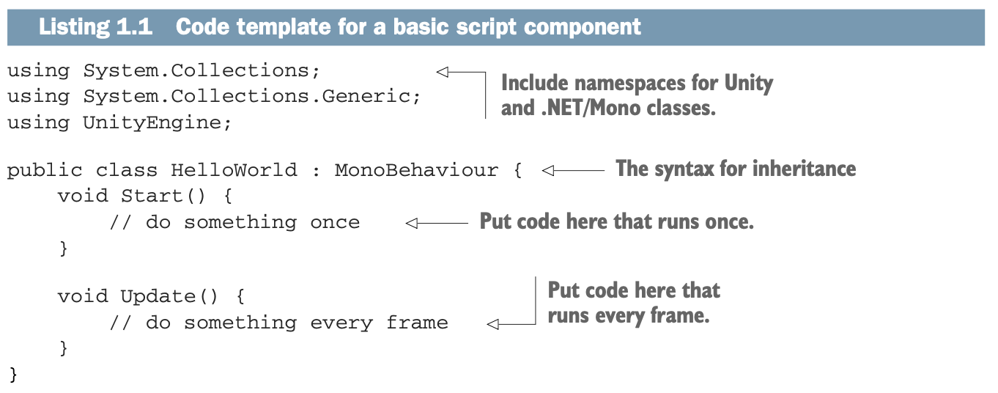
Script Components
1: Hocking, Joseph; Schell, Jesse, Unity in action: multiplatform game development in C#, 2022

Slide 15
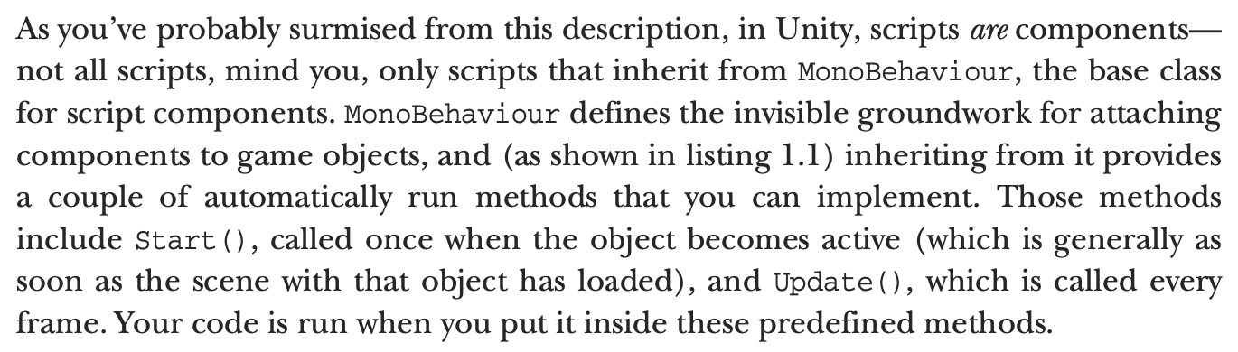
Script Components
1: Hocking, Joseph; Schell, Jesse, Unity in action: multiplatform game development in C#, 2022

Slide 16
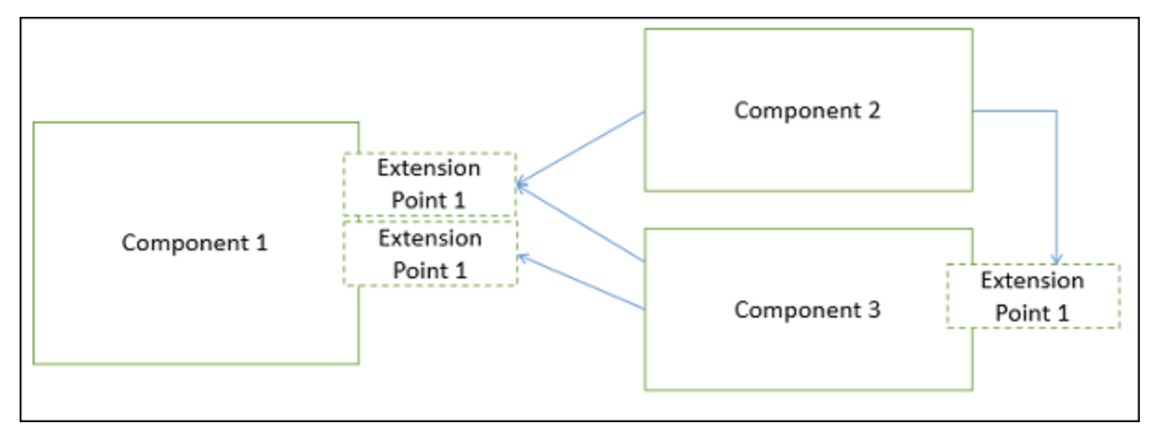
Advantages of Component-Based Design (CBD)
There are many advantages of developing the applications using the CBD
Ease of deployment − As new compatible versions become available, it is easier to replace existing versions with no impact on the other components or the system as a whole.
Reduced cost − The use of third-party components allows you to spread the cost of development and maintenance.
Ease of development − Components implement well-known interfaces to provide defined functionality, allowing development without impacting other parts of the system.
Reusable − The use of reusable components means that they can be used to spread the development and maintenance cost across several applications or systems.

Slide 17
Advantages of Component-Based Design (CBD)
Modification of technical complexity − A component modifies the complexity through the use of a component container and its services.
Reliability − The overall system reliability increases since the reliability of each individual component enhances the reliability of the whole system via reuse.
System maintenance and evolution − Easy to change and update the implementation without affecting the rest of the system.
Independent − Independency and flexible connectivity of components. Independent development of components by different group in parallel. Productivity for the software development and future software development.

Slide 18
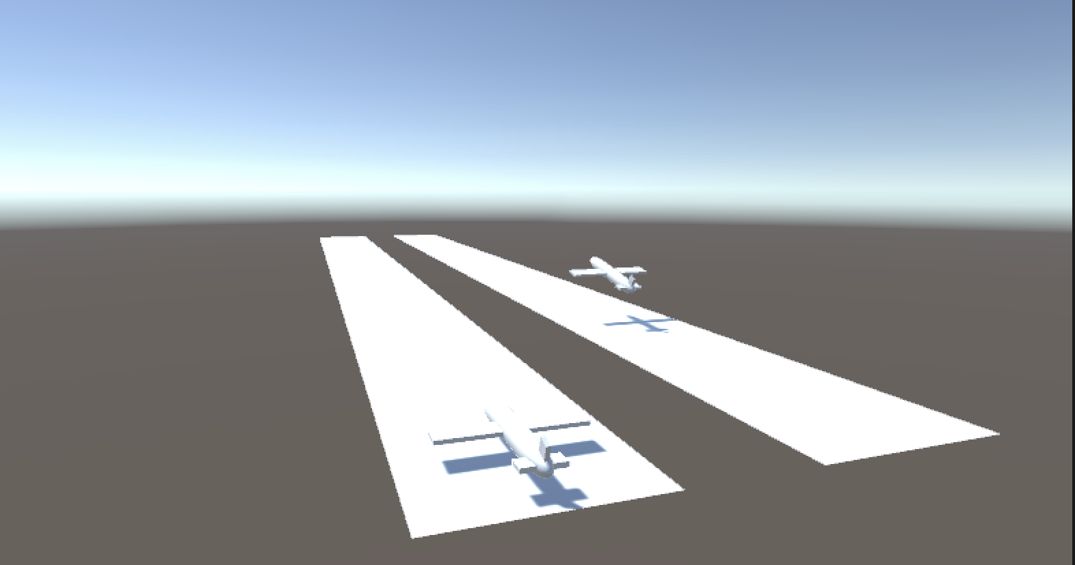
Hands-on
A. Create C# script component to control the Airplane
B. Follow camera
C. Add I/O control to Airplane
Notes:
For student: Open the file in:./Media/1.3_Practice-Final-Demo.mp4 to show the target of this practice.
Students need to follow the next slide's instructions to practice with Unity.
Practice Resources sharing:
https://drive.google.com/drive/folders/1eXu20cX1o-5uMFuSeHGxRS5AkhDZJTOP?usp=sharing
For lecturer: open file in: ./Lecturer-Guide/1.3_Component-System.mp4
And user Assets file in ./Lecturer-Guide/Assets/1.3_Component-System/*
To update the final project.

Slide 19
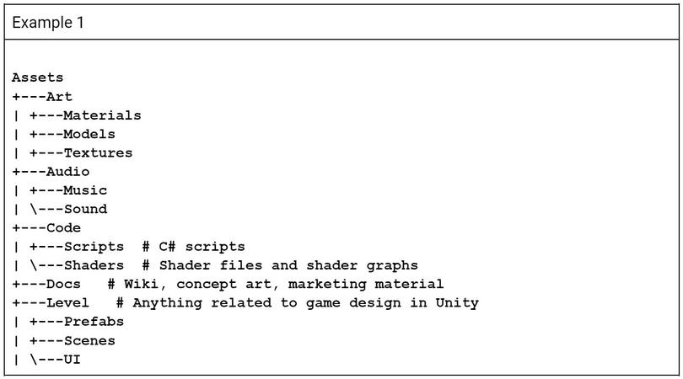
Practice Prepair
Hint: In order to organize the Assets folder, create the following folders:

Slide 20
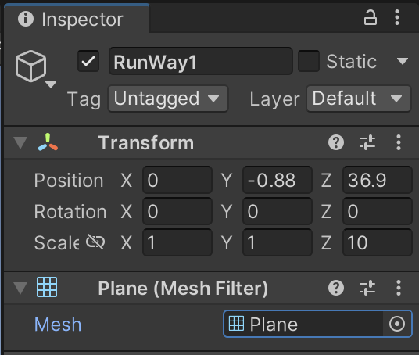
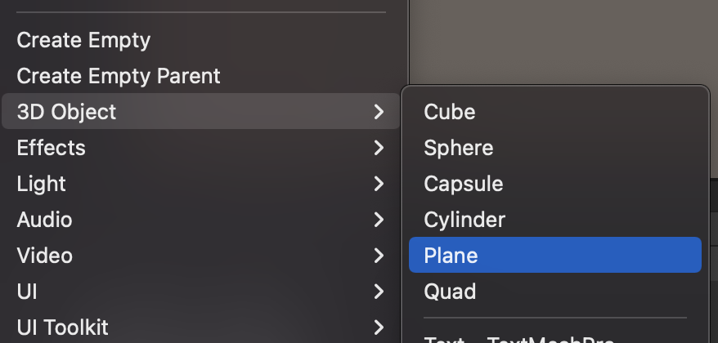
Practice 1 – Airplane take off
1. Add Plane to scene. Rename it to Runway. And Scale it to make Airplane’s Runway

Slide 21
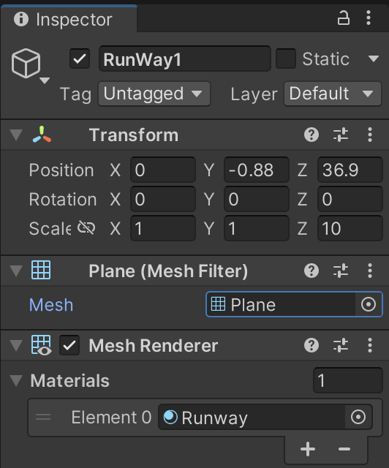
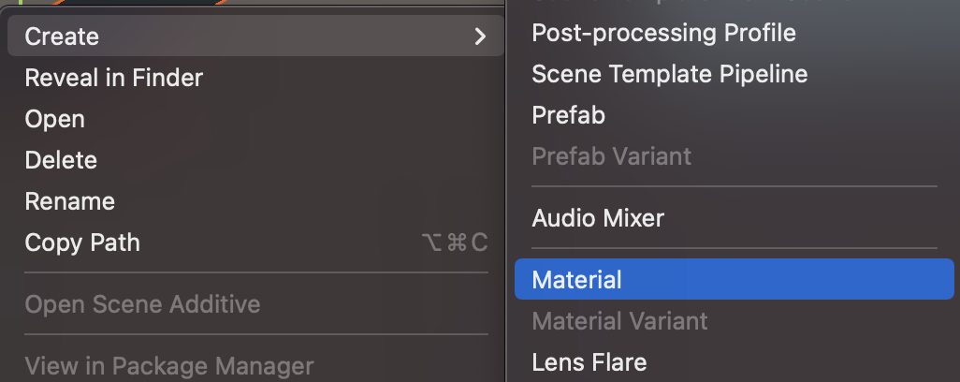
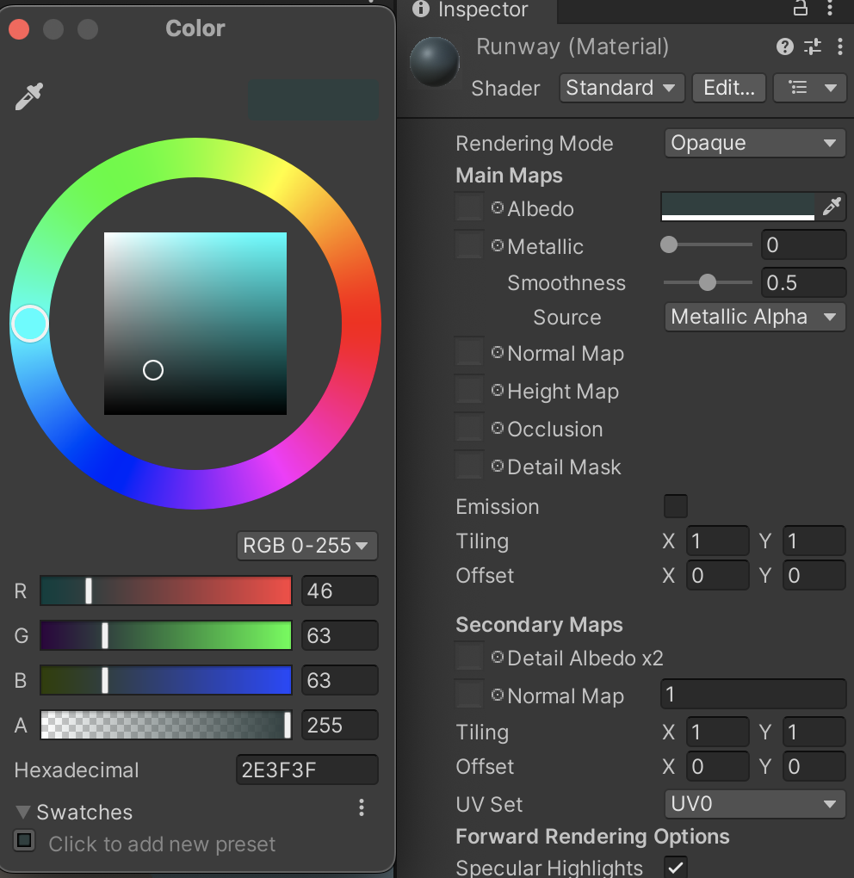
Practice 1 – Airplane take off
2. Create new material for runway (optional)
On Project window, select Asset folder for Material
Select Asset menu and choose Create > Material. Rename new material to Runway. On Inspector panel, choose Albedo color at you like.
Select RunWay GameObject, assign new material to GameObject by drag and drop new material to Material - Element 0

Slide 22
Practice 1 – Airplane take off
3. Add script component to Airplane GameObject
In Assets > Code > Scripts, right-click and choose Create > C# Script. Rename the script to ‘AirplaneTakeOff’.
Double-click on Script to open a C# script file in Virtual Studio Code. Follow this tutorial if you can not open VSC.
Paste Code in next slide to AirplaneTakeOff.cs file and Save
Drag and Drop script from asset to Inspector panel of GameObject
Notes:
https://docs.unity3d.com/Manual/VisualStudioIntegration.html

Slide 23
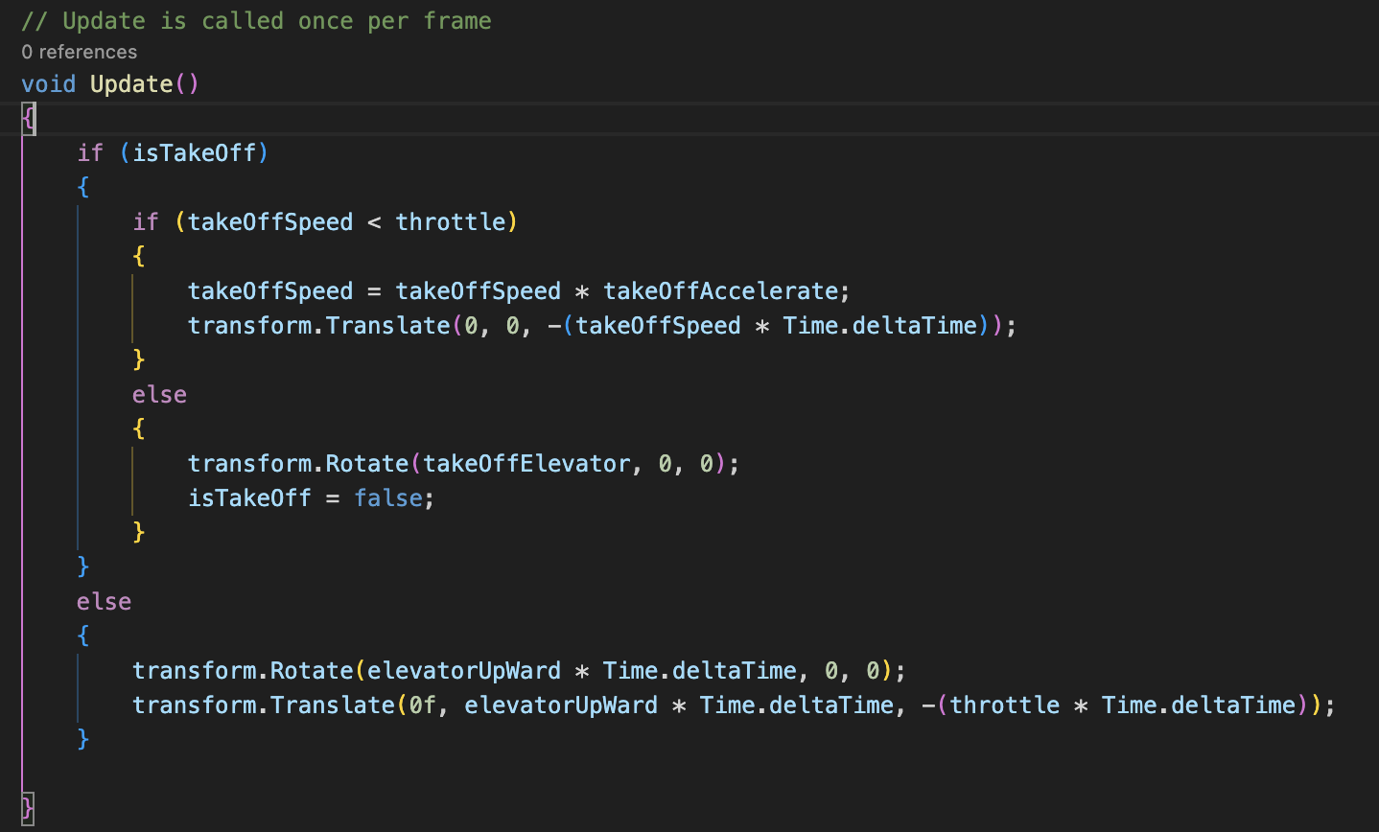
Practice 1 – Airplane take off
Notes:
using System.Collections;
using System.Collections.Generic;
using UnityEngine;
public class NewBehaviourScript : MonoBehaviour
{
// Elevator: Up / Down
[SerializeField] private float elevatorUpWard = 0f;
// Throttle (Speed): Up / Down
[SerializeField] float throttle = 30f;
// TODO Ailerons: Left / Right
// TODOO Rudder
// takeOffSpeed
[SerializeField] float takeOffSpeed = 9f;
// takeOffAccelerate
[SerializeField] private float takeOffAccelerate = 1.0072f;
[SerializeField] private bool isTakeOff = true;
[SerializeField] private float takeOffElevator = 3.5f;
// Start is called before the first frame update
void Start()
{
}
// Update is called once per frame
void Update()
{
if (isTakeOff)
{
if (takeOffSpeed < throttle)
{
takeOffSpeed = takeOffSpeed * takeOffAccelerate;
transform.Translate(0, 0, -(takeOffSpeed * Time.deltaTime));
}
else
{
transform.Rotate(takeOffElevator, 0, 0);
isTakeOff = false;
}
}
else
{
transform.Rotate(elevatorUpWard * Time.deltaTime, 0, 0);
transform.Translate(0f, elevatorUpWard * Time.deltaTime, -(throttle * Time.deltaTime));
}
}
}

Slide 24
Practice A – Airplane take off
using System.Collections;
using System.Collections.Generic;
using UnityEngine;
public class NewBehaviourScript : MonoBehaviour
{
// Elevator: Up / Down
[SerializeField] private float elevatorUpWard = 0f;
// Throttle (Speed): Up / Down
[SerializeField] float throttle = 30f;
// TODO Ailerons: Left / Right
// TODOO Rudder
// takeOffSpeed
[SerializeField] float takeOffSpeed = 9f;
// takeOffAccelerate
[SerializeField] private float takeOffAccelerate = 1.0072f;
[SerializeField] private bool isTakeOff = true;
[SerializeField] private float takeOffElevator = 3.5f;

Slide 25
Practice A – Airplane take off
// Start is called before the first frame update
void Start()
{
}
// Update is called once per frame
void Update()
{
if (isTakeOff)
{
if (takeOffSpeed < throttle)
{
takeOffSpeed = takeOffSpeed * takeOffAccelerate;
transform.Translate(0, 0, -(takeOffSpeed * Time.deltaTime));
}
else
{
transform.Rotate(takeOffElevator, 0, 0);
isTakeOff = false;
}
}
else
{
transform.Rotate(elevatorUpWard * Time.deltaTime, 0, 0);
transform.Translate(0f, elevatorUpWard * Time.deltaTime, -(throttle * Time.deltaTime));
}
}
}

Slide 26
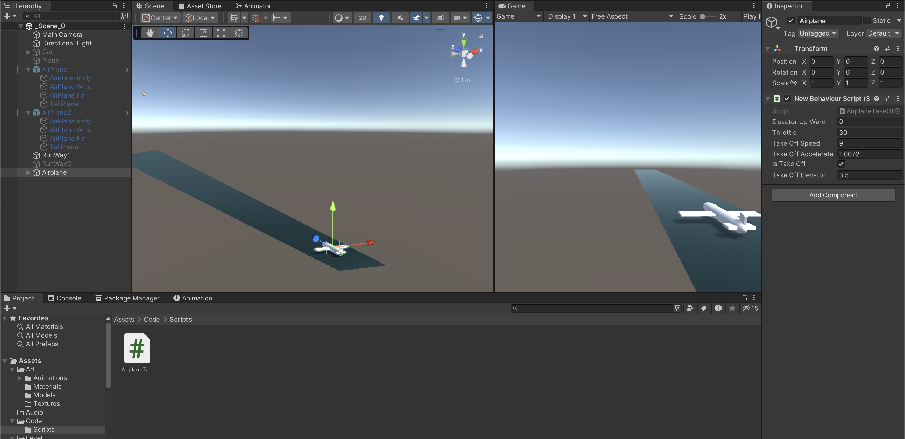
Practice A – Airplane take off

Slide 27
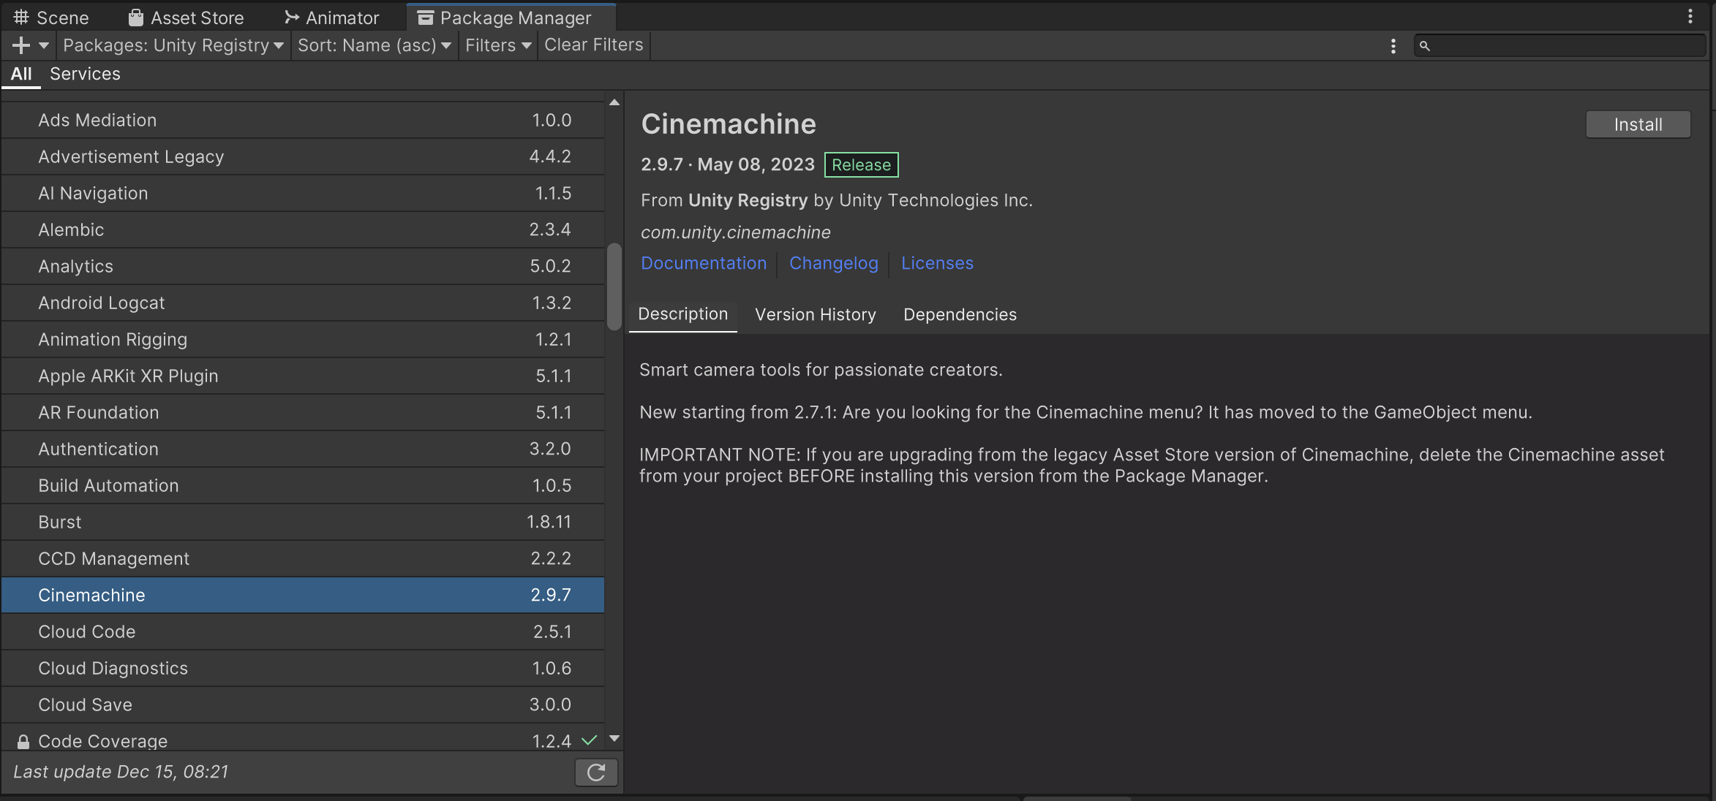
Practice B – Camera Follow Player
1. Install Cinemachine package
From Package Nanager pane, select Unity Registry
Find Cinemachine and click install

Slide 28
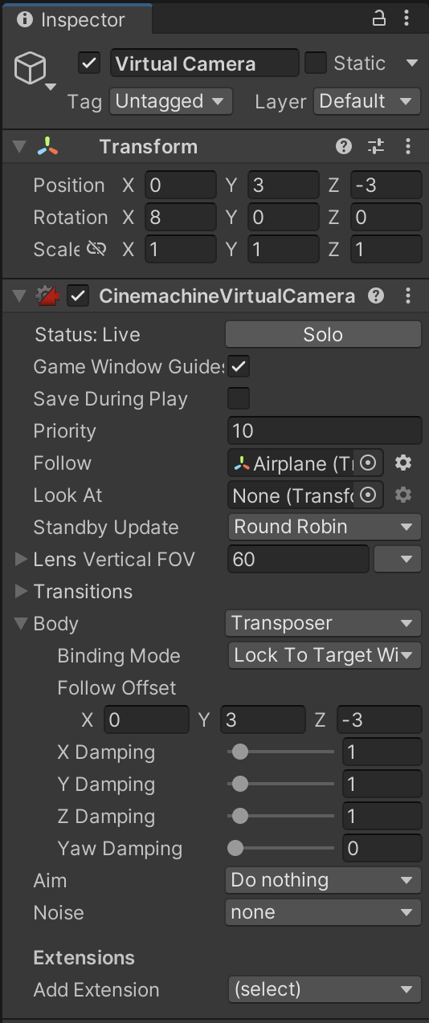
Practice B – Camera Follow Player
1. Add Virtual Camera to scene
- From menu, choose GameObject > Cinemachine > Virtual Camera. Reset and change transform of Virtual Camera to set GameObject view from camera.
- Drag and Drop Virtual Camera to GameObject (optional)
- Drag and Drop Player GameObject (Airplane object) to Follow property of Virtual Camera.
- Set Virtual Camera property to set best view to Airplane:
Follow: Airplane.
Body: Transpoter
Body – Follow Offset: X = 0, Y = 3, Z = -3
Aim: Do nothing

Slide 29
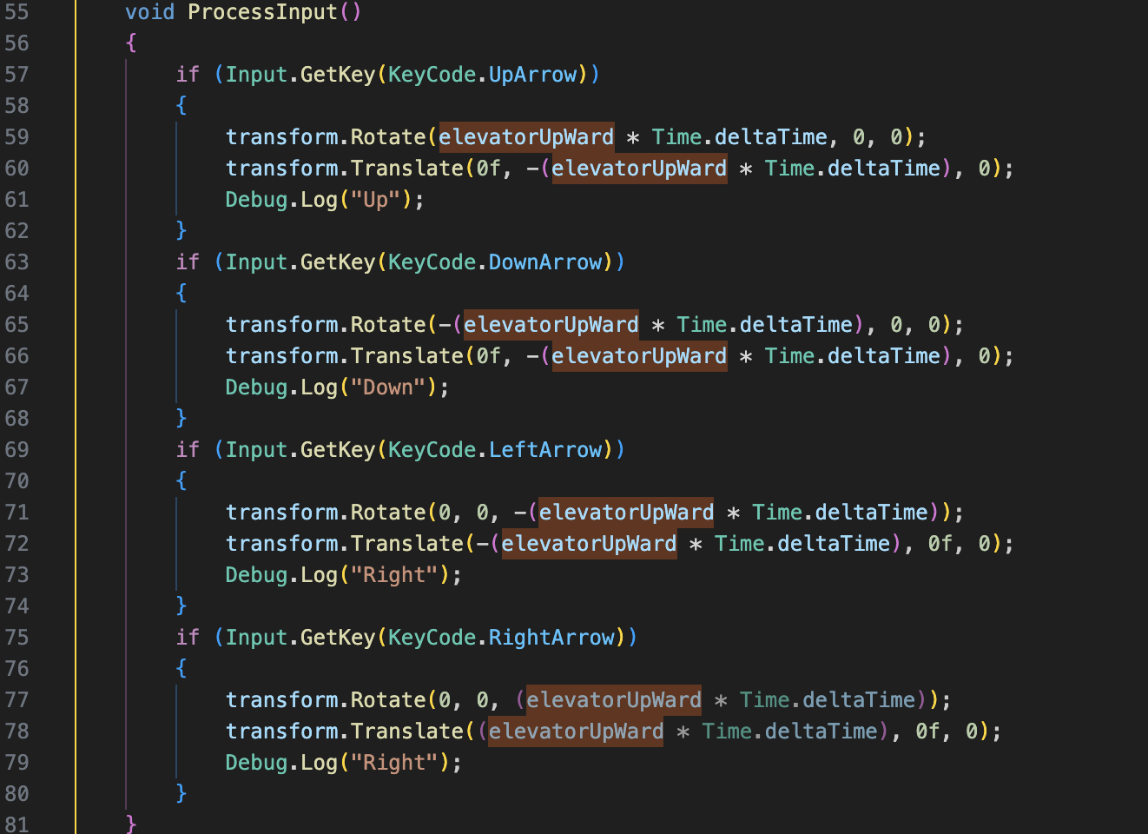
Practice B – Camera Follow Player
1. Add Input key to controll the Airplane
Add following function to AirplaneTakeOff Script
Notes:
void ProcessInput()
{
if (Input.GetKey(KeyCode.UpArrow))
{
transform.Rotate(elevatorUpWard * Time.deltaTime, 0, 0);
transform.Translate(0f, -(elevatorUpWard * Time.deltaTime), 0);
Debug.Log("Up");
}
if (Input.GetKey(KeyCode.DownArrow))
{
transform.Rotate(-(elevatorUpWard * Time.deltaTime), 0, 0);
transform.Translate(0f, -(elevatorUpWard * Time.deltaTime), 0);
Debug.Log("Down");
}
if (Input.GetKey(KeyCode.LeftArrow))
{
transform.Rotate(0, 0, -(elevatorUpWard * Time.deltaTime));
transform.Translate(-(elevatorUpWard * Time.deltaTime), 0f, 0);
Debug.Log("Right");
}
if (Input.GetKey(KeyCode.RightArrow))
{
transform.Rotate(0, 0, (elevatorUpWard * Time.deltaTime));
transform.Translate((elevatorUpWard * Time.deltaTime), 0f, 0);
Debug.Log("Right");
}
}

Slide 30
Conclusions
Understanding Unity's Component System: Explored the modular approach where components encapsulate entity functionalities.
Exploration of Common Components: Introduced vital components like Transform, Renderer, Collider, Rigidbody, and Scripts, elucidating their roles and importance.
Component-Based Design Advantages: Discussed the benefits—reusability, modularity, extensibility — of this design approach.

Slide 31
References
1: Hocking, Joseph; Schell, Jesse, Unity in action: multiplatform game development in C#, 2022
3: Geig, Mike, Sams teach yourself Unity Game development in 24 hours, 2014
6: Gibson Bond, Jeremy, Introduction to Game Design, Prototyping, and Development: From Concept to Playable Game with Unity and C,
8: Unity Technologies, Unity Manual, 2023
9: Tutorials Point, Learning Unity, 2023
10: Goldstone Will, Unity 3.x game development essentials, 2011

